Slide 1

6th Grade Accelerated Math
Unit 7, Lesson 4 Deriving Area Formulas for Trapezoids, Parallelograms, and Rhombi Volume 1, pg. 314

Slide 2


Benchmark
MA.7.GR.1.1
Apply formulas to find the areas of trapezoids, parallelograms, and rhombi.
volume 1, pg. 314

Slide 3
Integrated Mathematical Thinking and Reasoning Standards
MA.K12.MTR.1.1 Actively participate in effortful learning both individually and collectively.
MA.K12.MTR.2.1 Demonstrate understanding by representing problems in multiple ways.
MA.K12.MTR.4.1 Engage in discussions that reflect on the mathematical thinking of self and others.
MA.K12.MTR.5.1 Use patterns and structure to help understand and connect mathematical concepts.
volume 1, pg. 314

Slide 4

Learning Target
I can use the formulas for the area of triangles and rectangles to derive formulas for the area of trapezoids, parallelograms, and rhombi.
volume 1, pg. 314

Slide 5

Warm-Up
volume 1, pg. 315

Slide 6
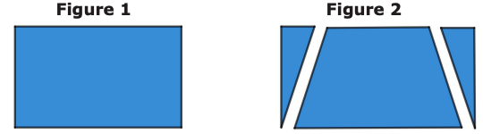
7.4.1 Warm-Up: Notice and Wonder
Two figures are shown.
What do you notice about these two figures?
What do you wonder about the figures?
volume 1, pg. 315

Slide 7

Refresher
volume 1, pg. 315

Slide 8

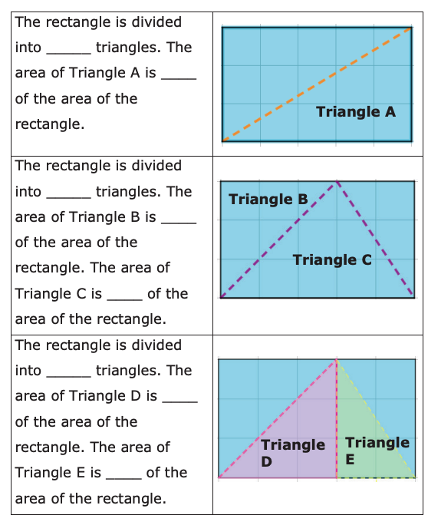
7.4.2 Refresher: Decomposing to Find the Area of a Triangle
Figures can be decomposed into smaller pieces that are then rearranged and composed into other shapes. Decomposing is useful when finding the area of a figure.
1. Complete the table.
volume 1, pg. 315

Slide 9

Activity
volume 1, pg. 316

Slide 10



7.4.3 Activity: Deriving the Formula for the Area of a Parallelogram
A parallelogram is a type of quadrilateral. Not only does a parallelogram have four sides and four vertices, but its opposite sides are also parallel.
volume 1, pg. 316

Slide 11
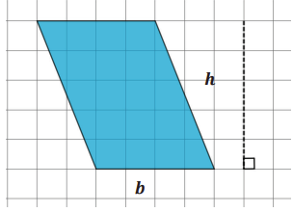
A parallelogram is shown on a grid with each gridline representing one unit.
Complete each statement.
The base of the parallelogram is _____ units.
The height of the parallelogram is _____ units.
volume 1, pg. 316

Slide 12
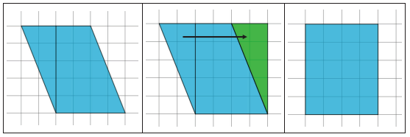
2. The images below show the same parallelogram being decomposed and then rearranged to form a rectangle.
Complete each statement.
The base of the rectangle is _____ units.
The height of the rectangle is _____ units.
volume 1, pg. 316

Slide 13
3. Discuss with your partner the relationship between the area of the parallelogram and the area of the rectangle. Write a summary of your discussion.
volume 1, pg. 317

Slide 14
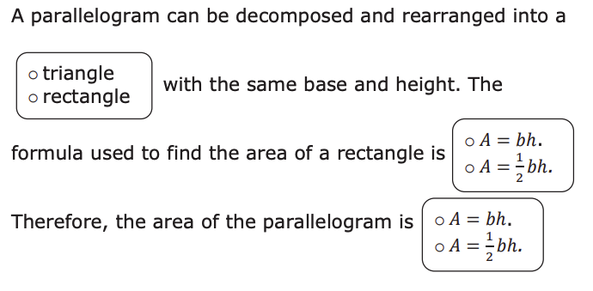
4. Complete the statements.
volume 1, pg. 317

Slide 15
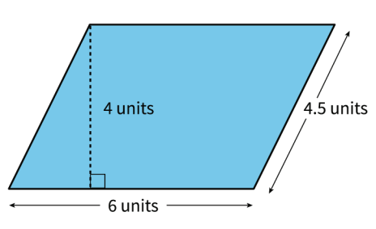
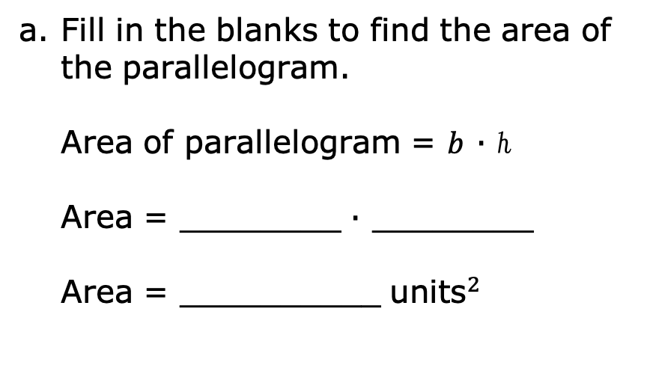
5. A parallelogram with its dimensions labeled is shown.
Fill in the blanks to find the area of the parallelogram.
Area of parallelogram = 𝑏 ∙ ℎ
Area = ________ ∙ ________
Area = __________ ${\text{units}}^{2}$
b. Three lengths are shown in the figure. With your partner, discuss the length that was not used to find the area of the parallelogram. Then, write an explanation for why this length was not used.
volume 1, pg. 317

Slide 16
Activity
volume 1, pg. 318

Slide 17

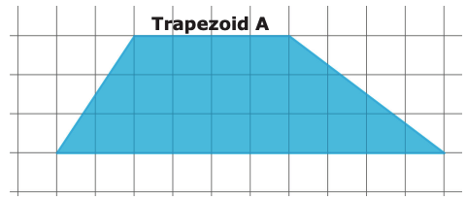
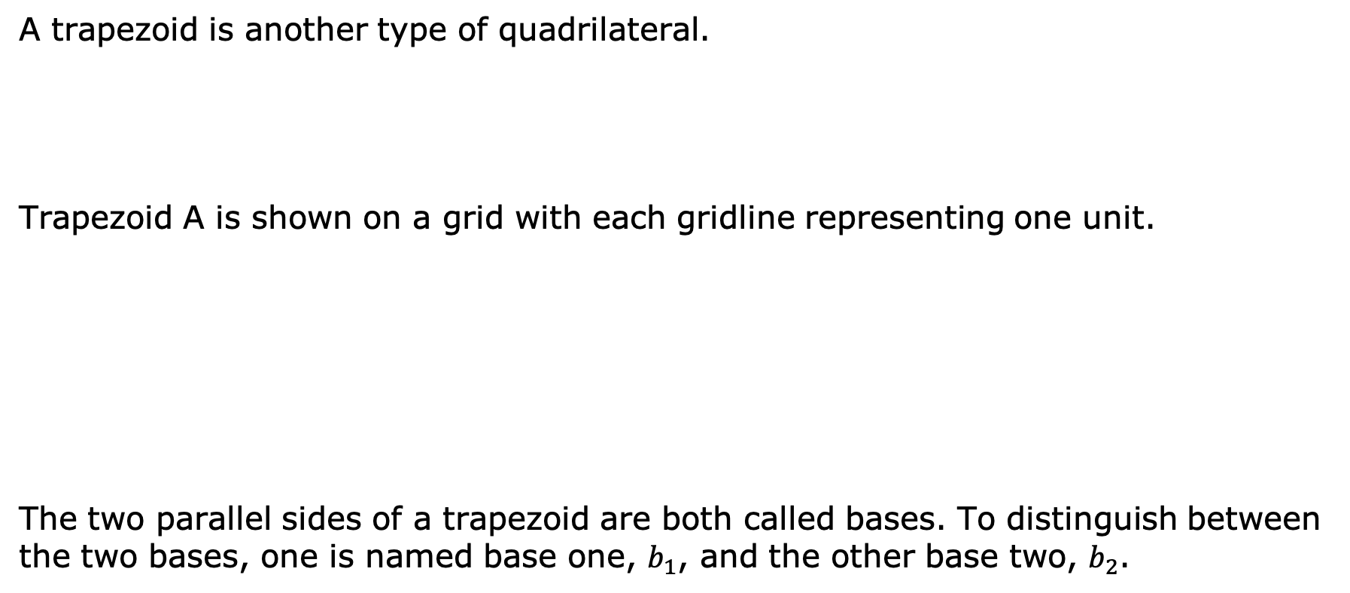
7.4.4 Activity: Deriving the Formula for the Area of a Trapezoid
A trapezoid is another type of quadrilateral.
Trapezoid A is shown on a grid with each gridline representing one unit.
The two parallel sides of a trapezoid are both called bases. To distinguish between the two bases, one is named base one, $b_{1}$, and the other base two, $b_{2}$.
volume 1, pg. 318

Slide 18
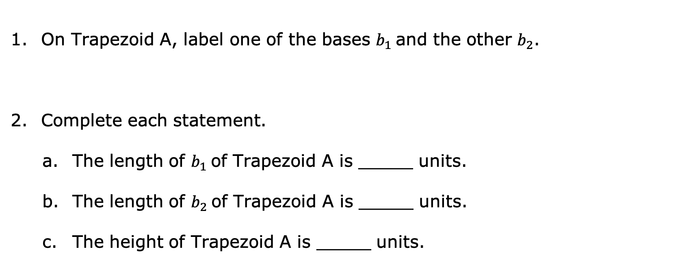
On Trapezoid A, label one of the bases $b_{1}$and the other $b_{2}$.
Complete each statement.
The length of $b_{1}$of Trapezoid A is _____ units.
The length of $b_{2}$of Trapezoid A is _____ units.
The height of Trapezoid A is _____ units.
volume 1, pg. 318

Slide 19
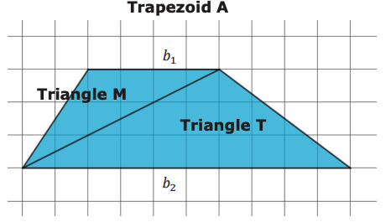
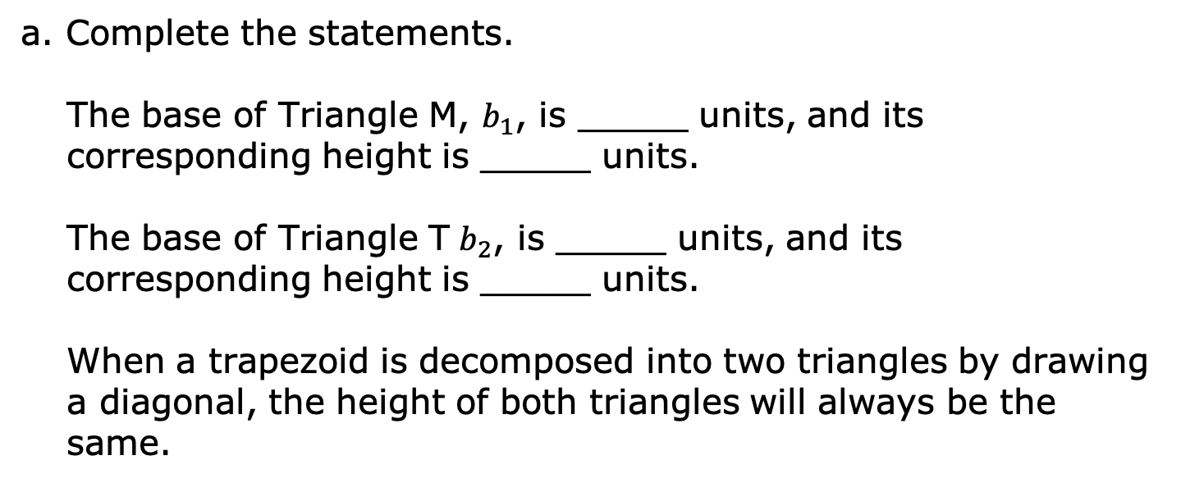
3. Trapezoid A is decomposed into two triangles and labeled, as shown below.
a. Complete the statements.
The base of Triangle M, $b_{1}$, is _____ units, and its corresponding height is _____ units.
The base of Triangle T $b_{2}$, is _____ units, and its corresponding height is _____ units.
When a trapezoid is decomposed into two triangles by drawing a diagonal, the height of both triangles will always be the same.
volume 1, pg. 318

Slide 20
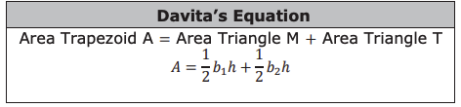
b. Davita wrote a formula for the area of Trapezoid A.
Explain how Davita determined this formula.
volume 1, pg. 319

Slide 21
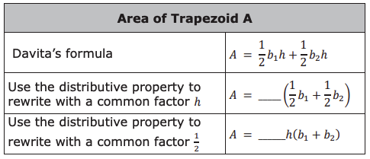
c. The formula Davita wrote can be used to find the area of any trapezoid. Complete the steps described in the table to rewrite the formula.
volume 1, pg. 319

Slide 22
Activity
volume 1, pg. 319

Slide 23

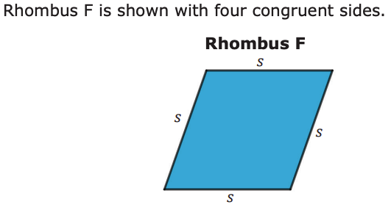
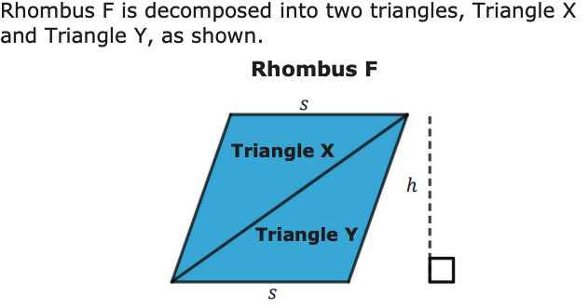
7.4.5 Activity: Deriving the Formula for the Area of a Rhombus
A rhombus is another type of quadrilateral.
volume 1, pg. 319

Slide 24
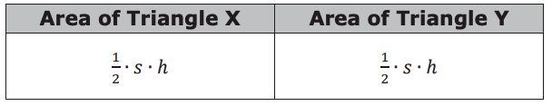
Felicia wrote expressions to represent the areas of the two triangles.
Discuss with your partner whether you agree with the expressions Felicia wrote. Write a summary of your discussion.
volume 1, pg. 320

Slide 25
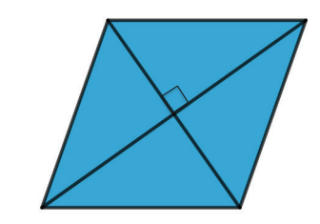
The diagonals of a rhombus can also be used to find its area.
The two diagonals of a rhombus are perpendicular to each other and divide each other in half.
volume 1, pg. 320

Slide 26
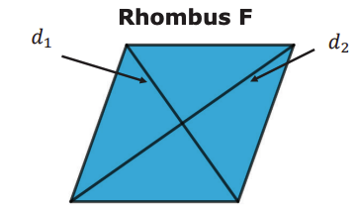

2. The two diagonals, $d_{1 }$and $d_{2}$, of Rhombus F are drawn and labeled below.
Mark on the figure the two lengths that are equal to $\frac{1}{2}d_{1}$and the two lengths that are equal to $\frac{1}{2}d_{2}$.
volume 1, pg. 320

Slide 27
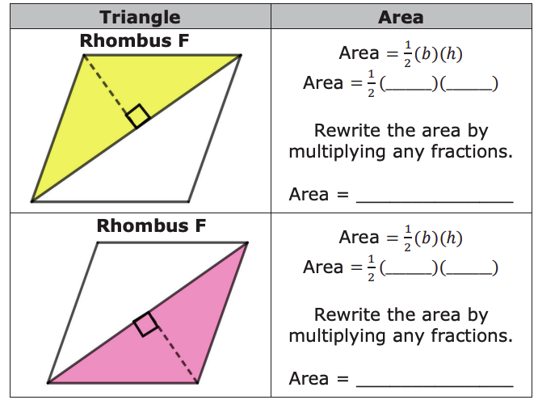
3. The first column of the table shows Rhombus F with parts highlighted. Use the lengths marked on Rhombus F in the previous question to fill in the blanks to find the area of the triangles.
volume 1, pg. 320

Slide 28
4. Compare your work with your partner and resolve any differences, if necessary.
5. Work with your partner to express the area of Rhombus F as the sum of the area of the yellow triangle and the pink triangle found in the table.
Area of Rhombus F = __________________________
volume 1, pg. 321

Slide 29

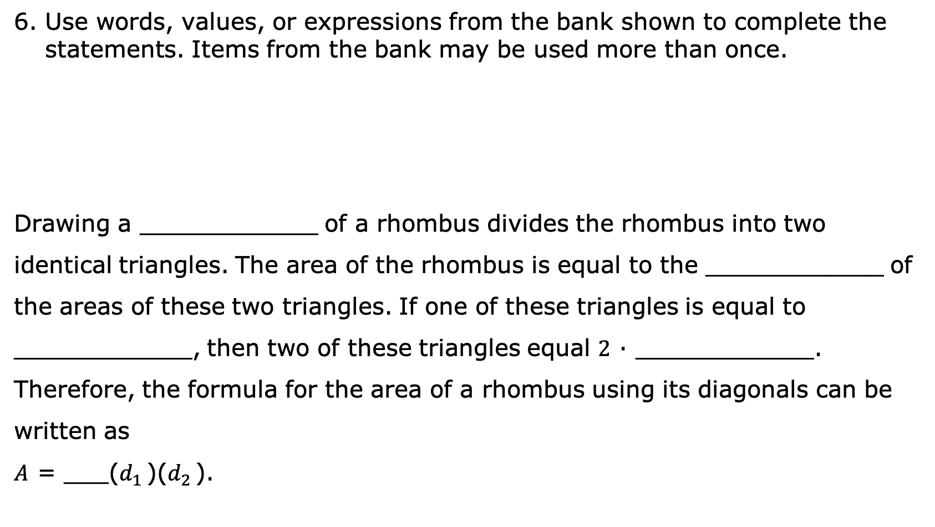
6. Use words, values, or expressions from the bank shown to complete the statements. Items from the bank may be used more than once.
Drawing a ____________ of a rhombus divides the rhombus into two identical triangles. The area of the rhombus is equal to the ____________ of the areas of these two triangles. If one of these triangles is equal to ____________, then two of these triangles equal 2 ∙ ____________. Therefore, the formula for the area of a rhombus using its diagonals can be written as
𝐴 = ___($d_{1 }$)($d_{2 }$).
volume 1, pg. 321

Slide 30

Wrap-Up
volume 1, pg. 321

Slide 31

7.4.6 Wrap-Up: Reflection
1. What was the muddiest (most difficult or confusing) point for you in today’s lesson on deriving the formula of parallelograms, trapezoids, and rhombi?
volume 1, pg. 321

